Slide 1
Boutiq travel ambassador program GA Capstone project
Johnny Huynh

Slide 2
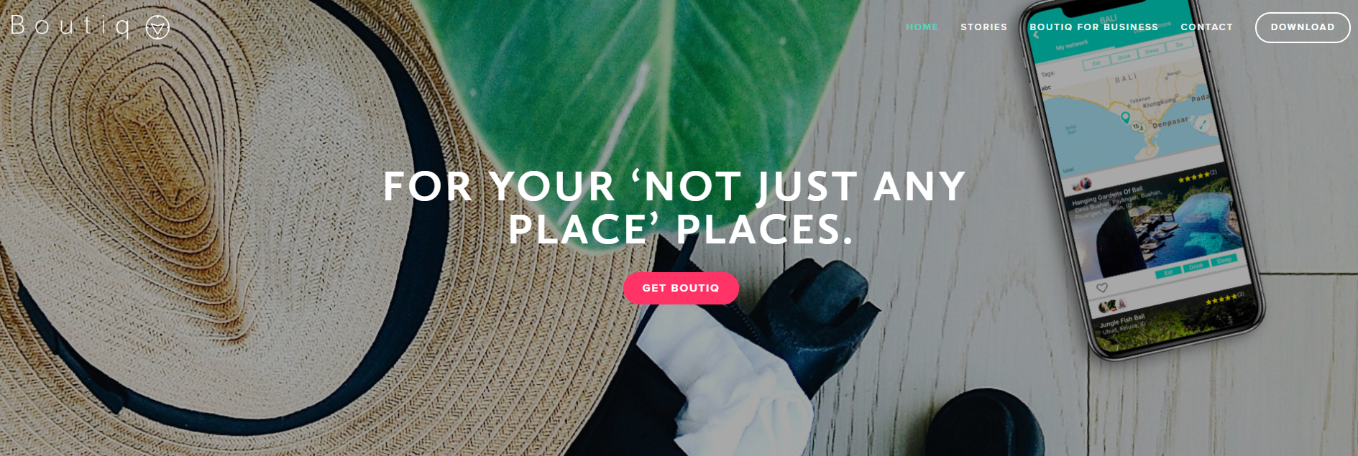
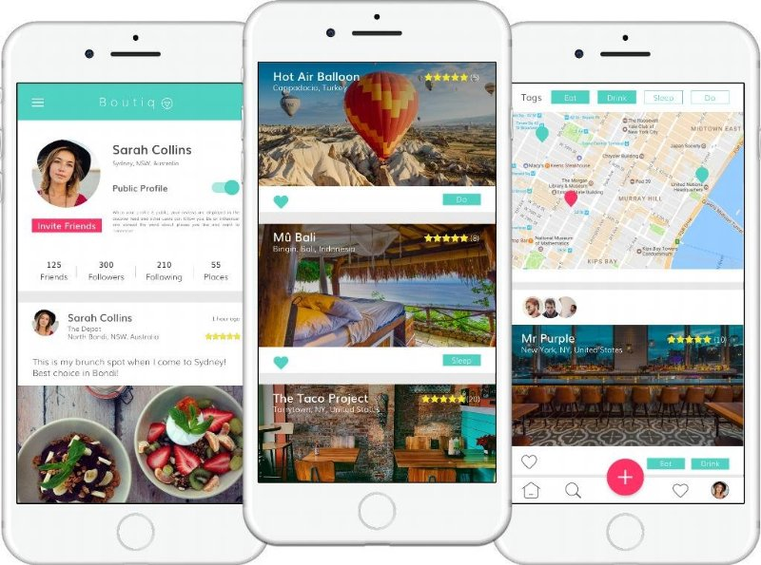
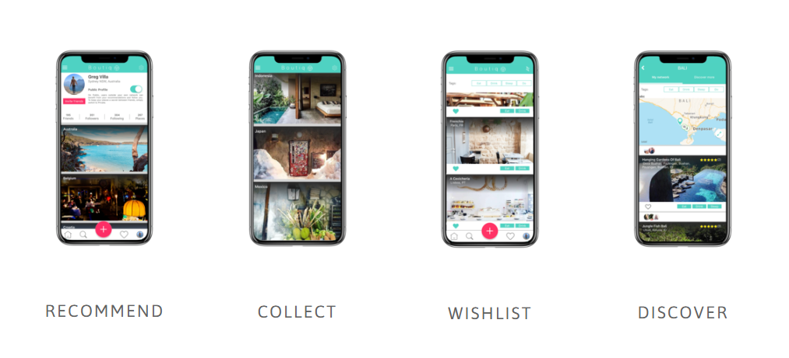
introduction
Leveraging the power of YOUR social networks
A memory bank to recommend places visited
A trip planning App, with search and quality visuals at its core

Slide 3
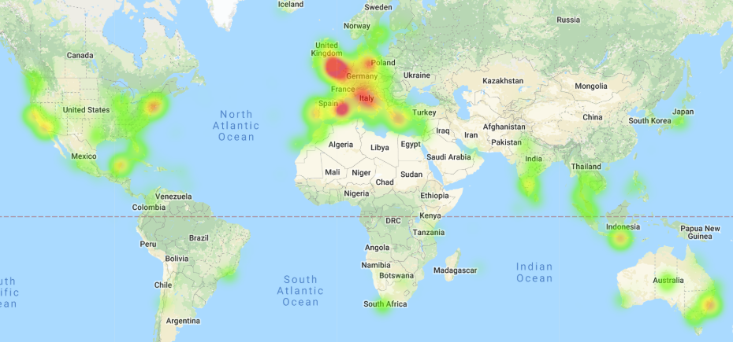
Where our users come from?

Slide 4
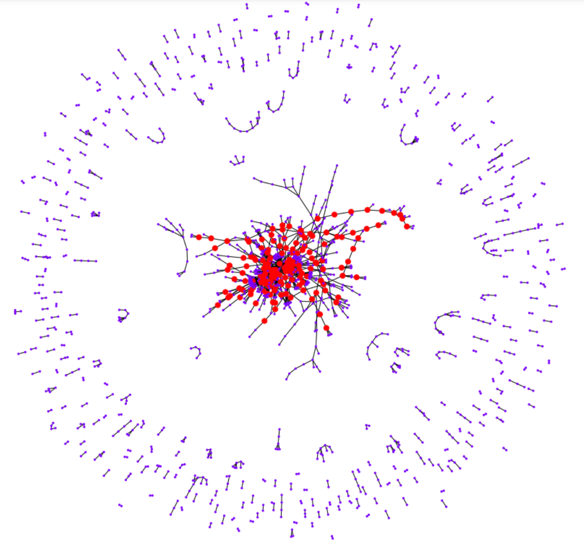
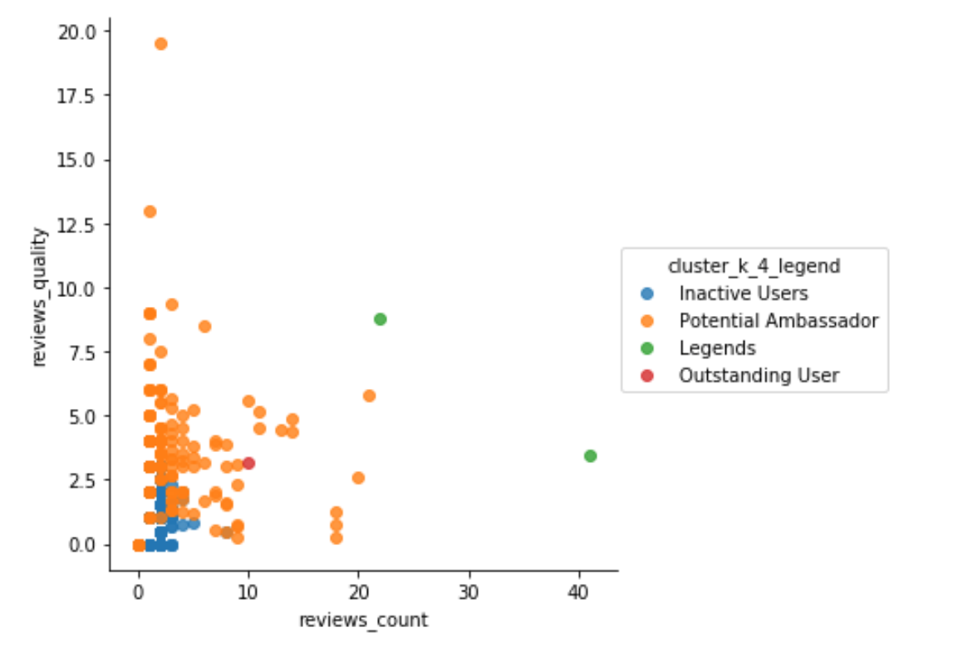
AMBASSADOR?
Goal:
Identify the most active group of users to grant them Ambassador title.
Techniques:
K-means clustering: measure the similarity of users and place them into the same group.
Social Network Analysis (SNA): identify the most ‘central’ users who act as a ‘transport hub’ where many other connections have to pass through

Slide 5
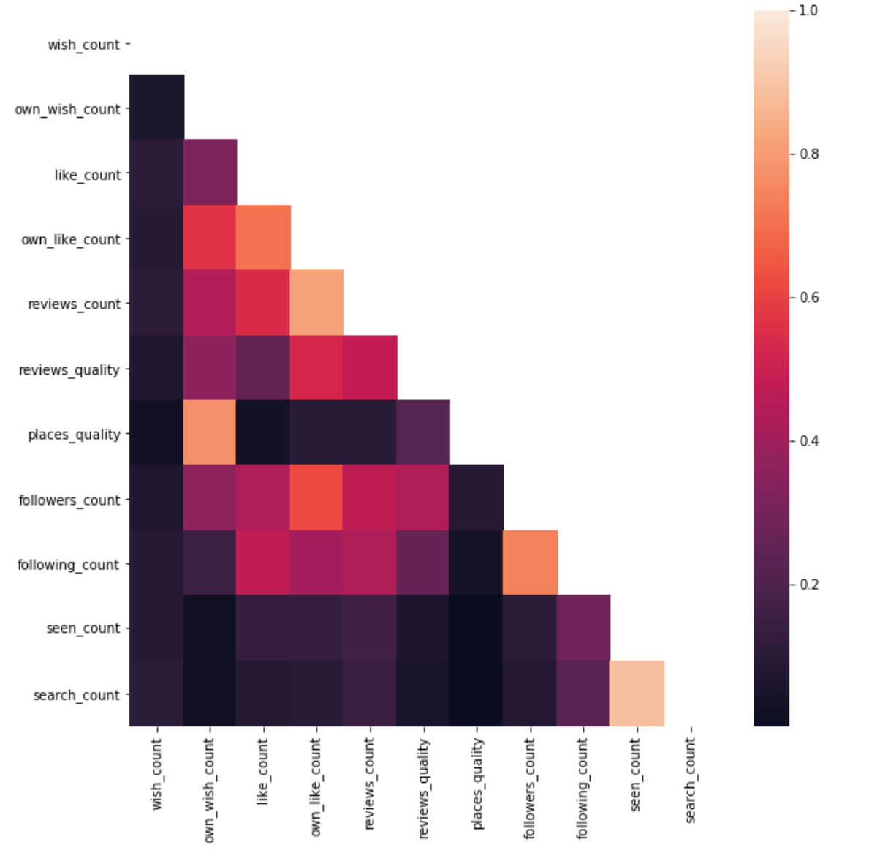
K-means clustering – FROM ID 2004
Features:
wish_count, like_count
own_wish_count, own_like_count, reviews_count, followers_count (most important)
reviews_quality, places_quality
following_count, seen_count, search_count
High correlation is good because they are a
good combination to indicate the activeness.
Some highly correlated pairs:
reviews_count and own_like_count
followers_count and following_count
seen_count and search_count

Slide 6
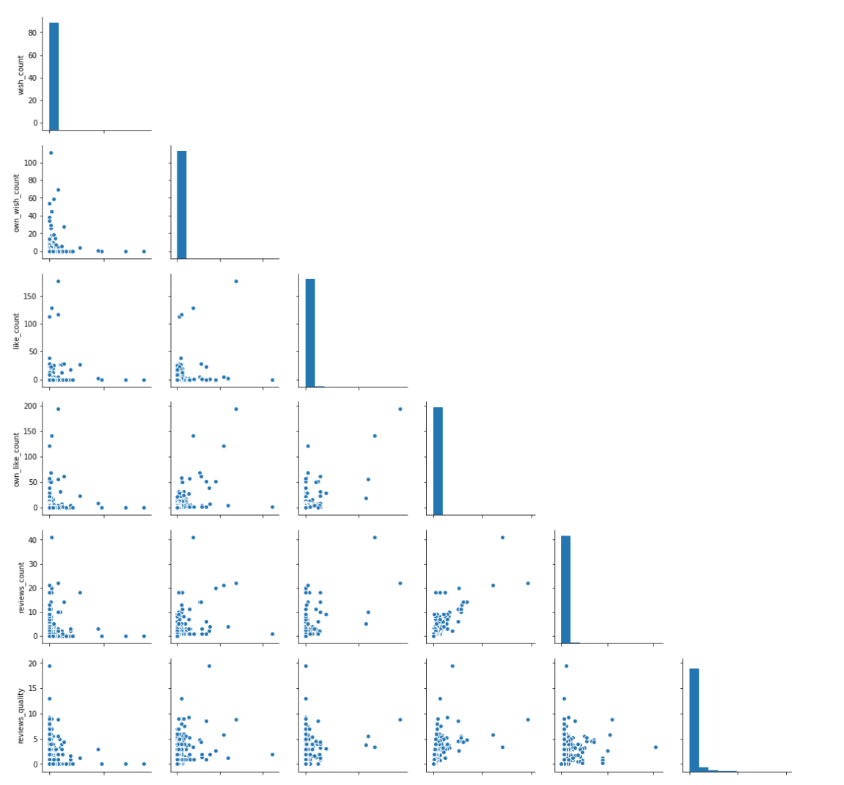

K-means clustering
Distribution are right skewed :
Not so many users use the app, or they haven’t engaged yet

Slide 7
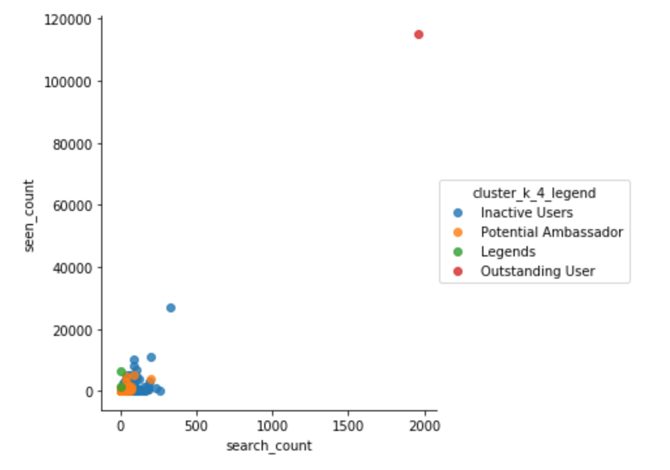
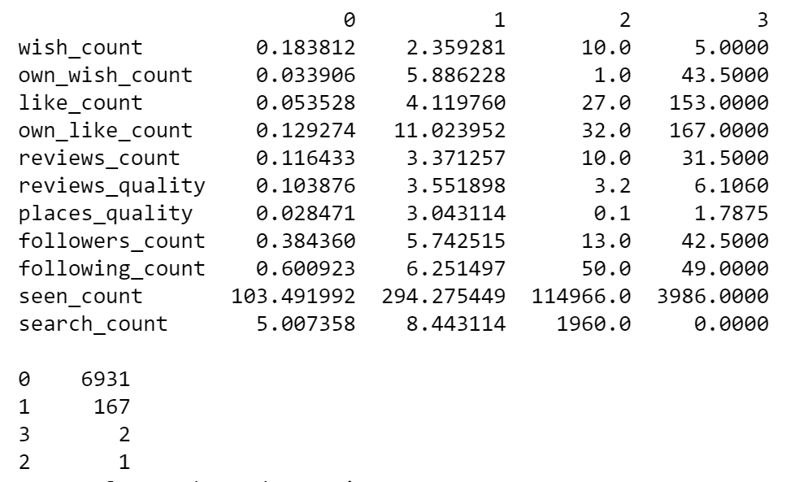
K-means clustering
4 clusters in total after try with k equals 3, 4 and 5.
Cluster centroids:

Slide 8
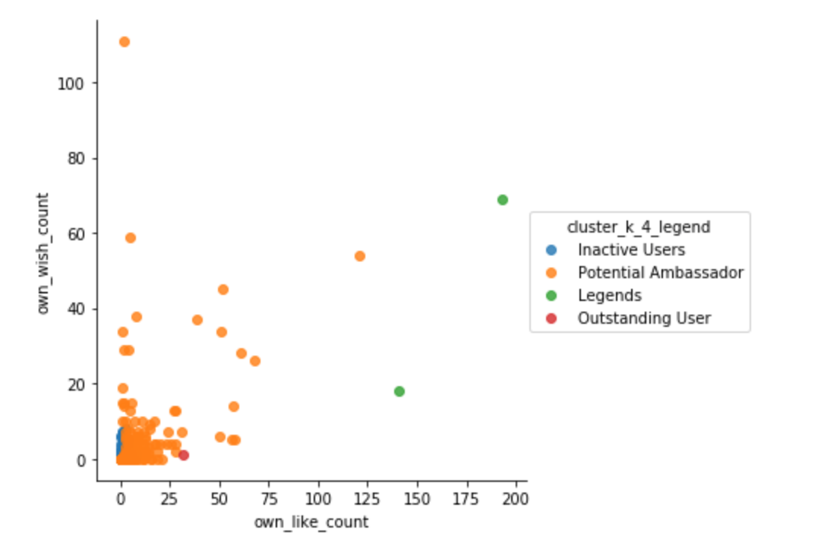
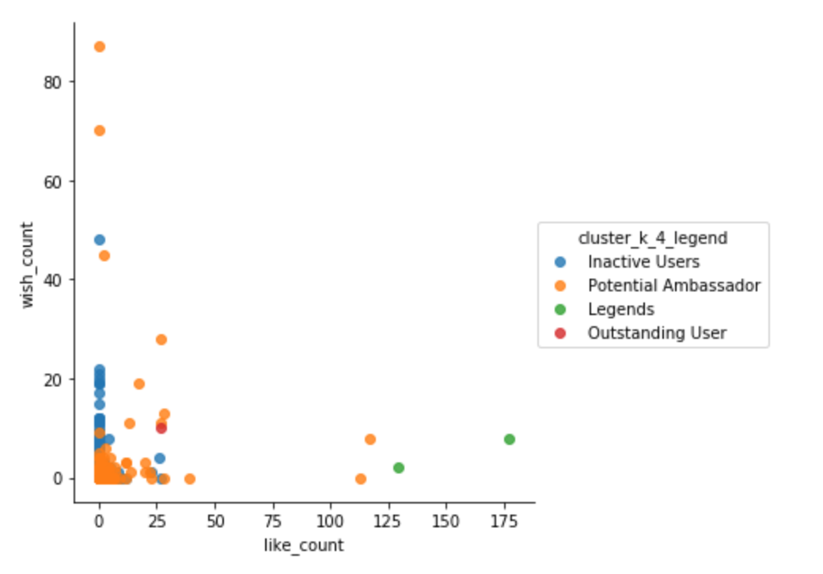
K-means clustering
Legends & Potential Ambassador ➔ Highly Actives Users

Slide 9
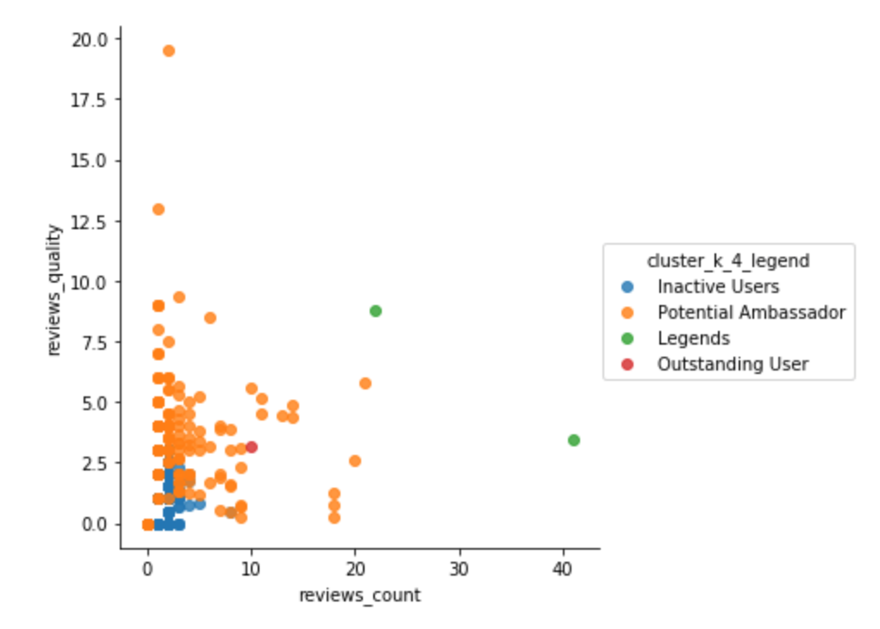
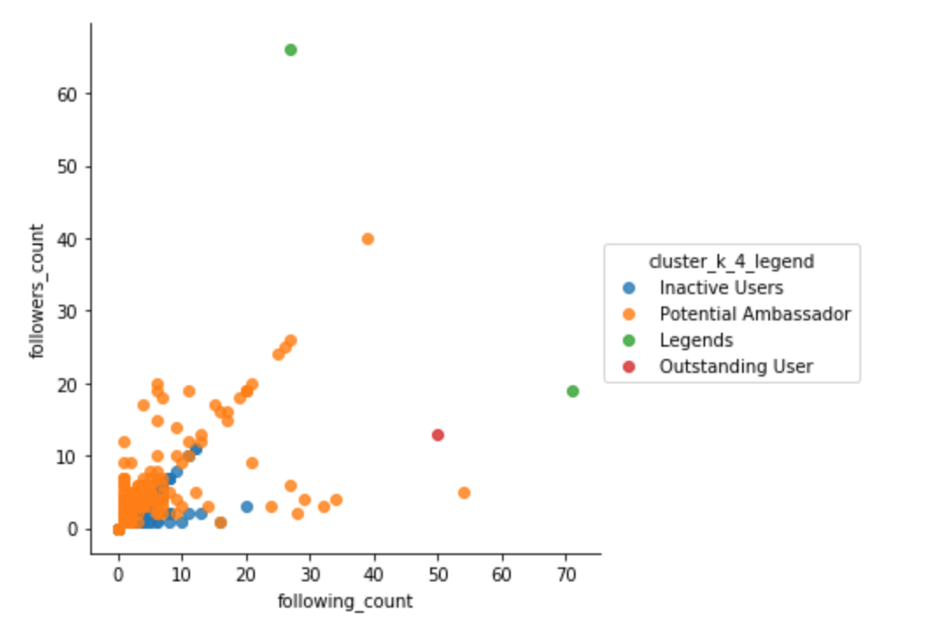
K-means clustering
167 highly active users in total.

Slide 10
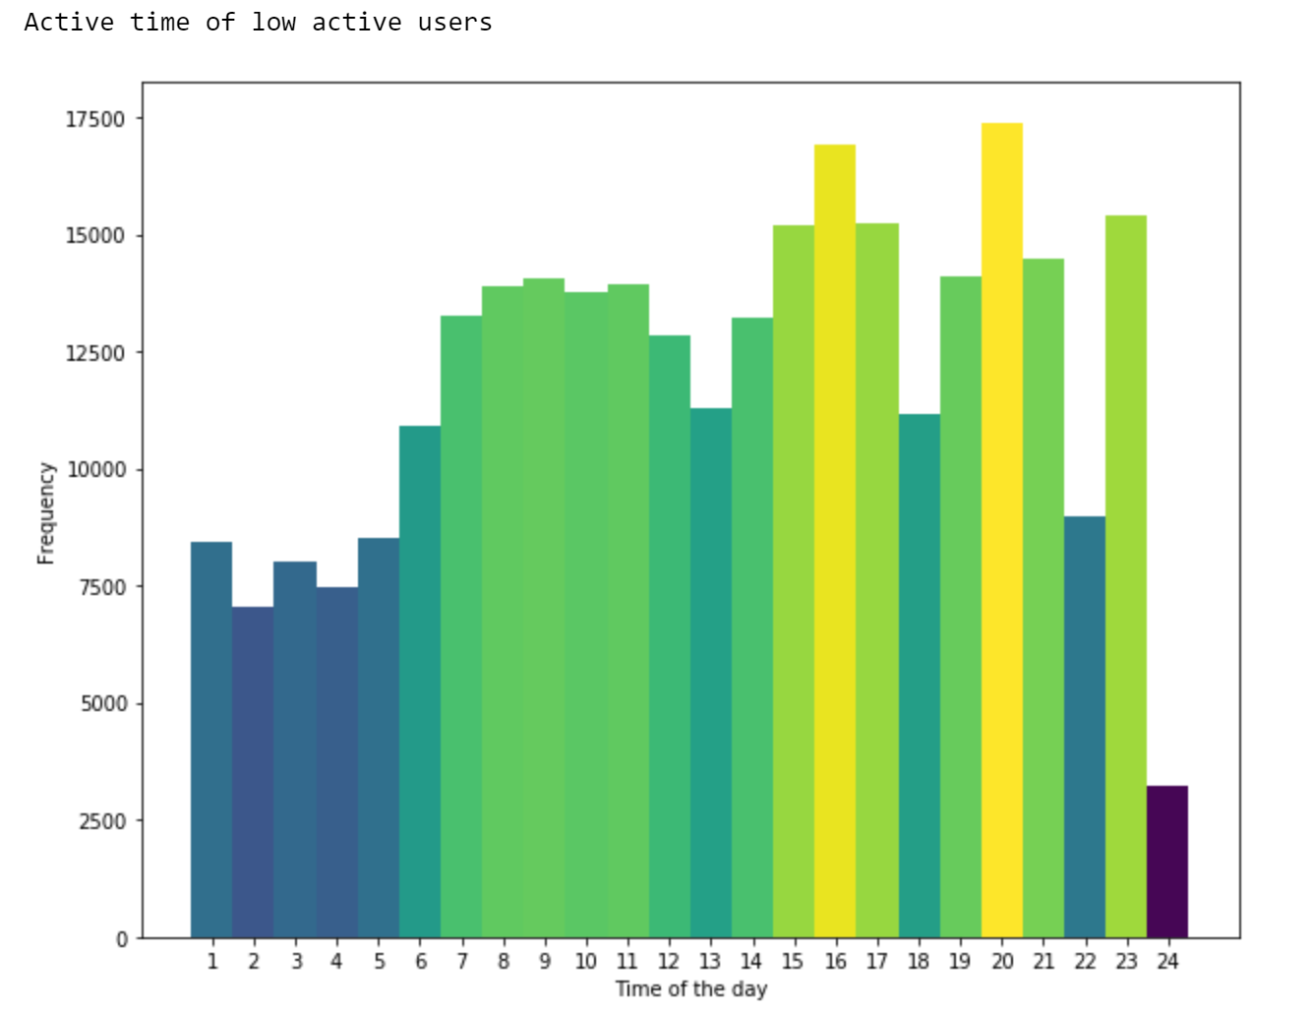
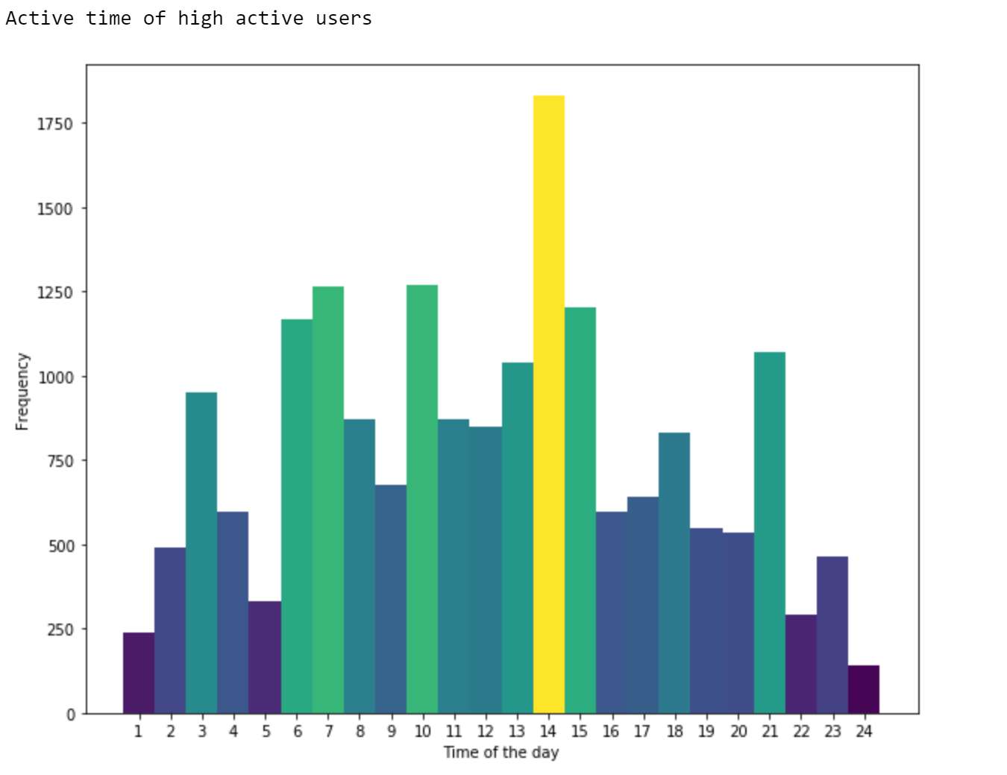
Online time
active users v.s. Inactive users

Slide 11
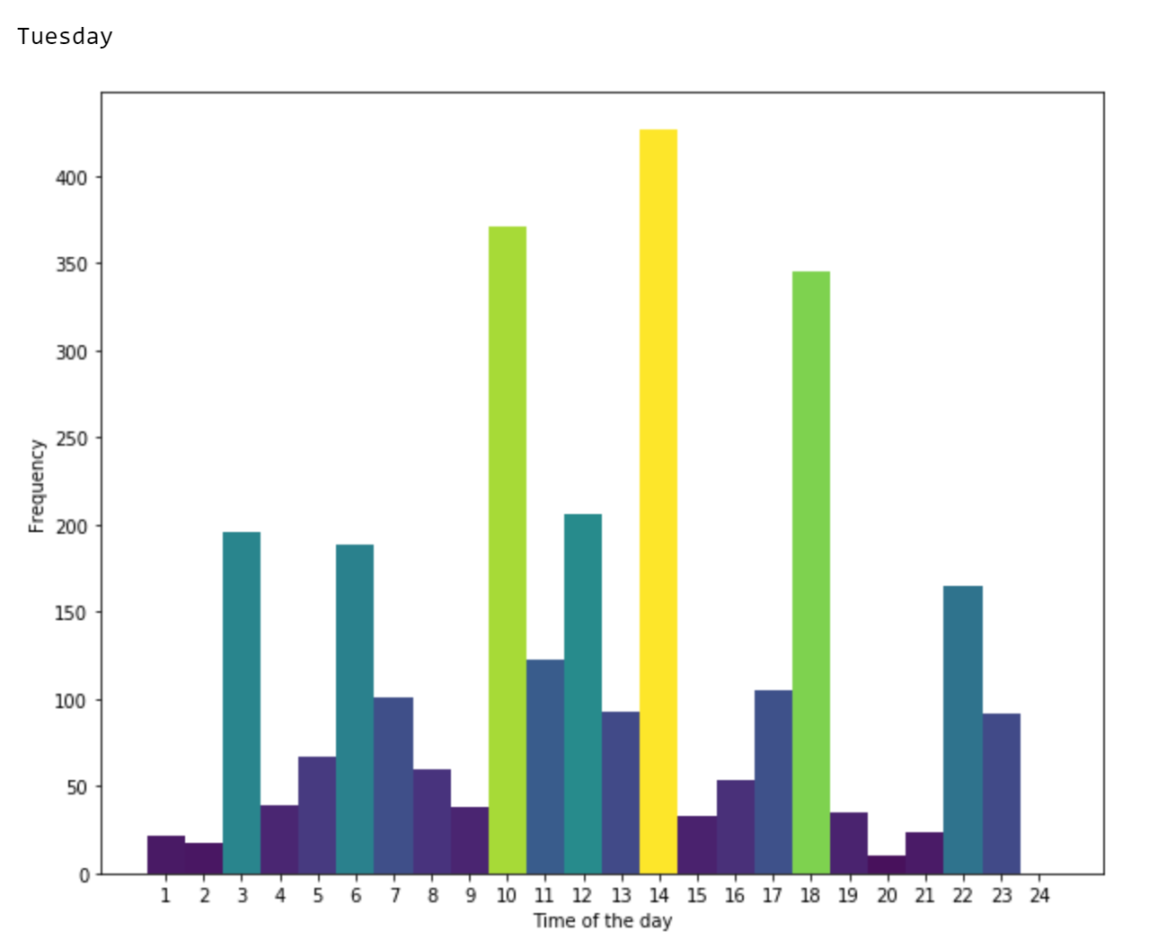
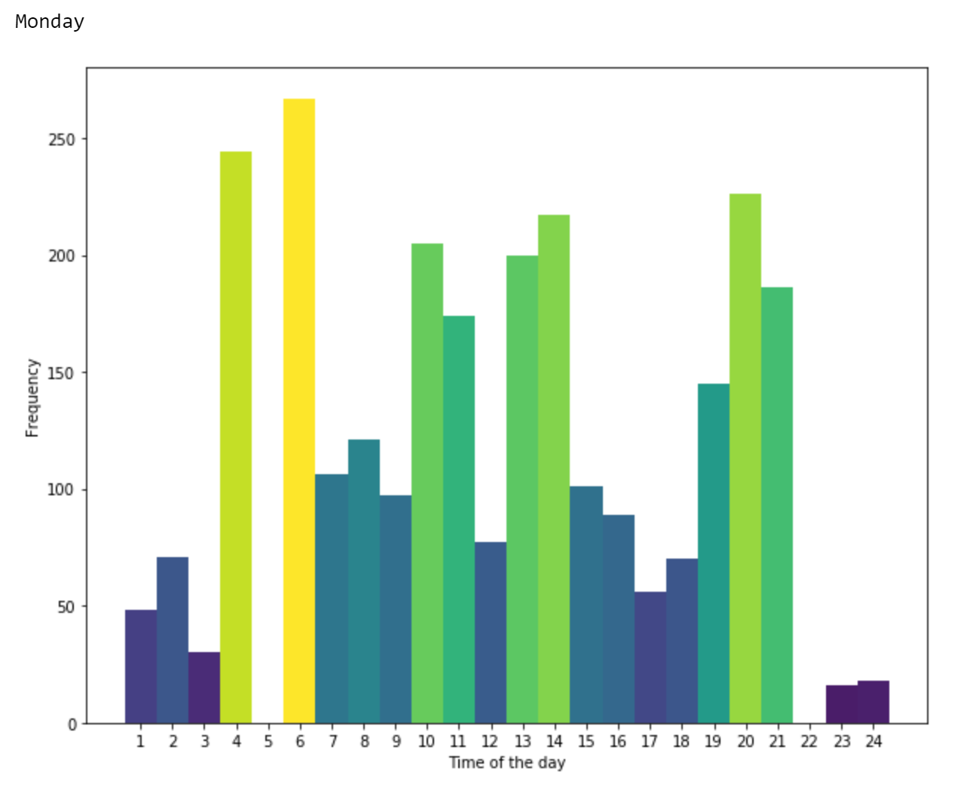
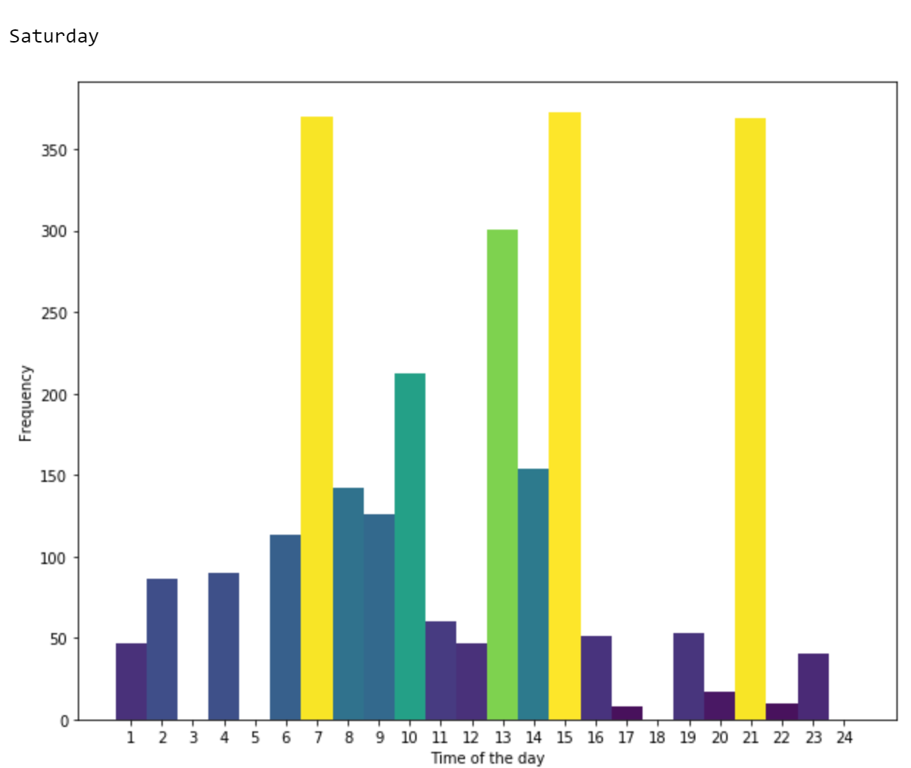
Online time
Difference for weekday?

Slide 12
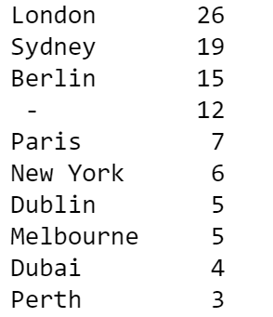
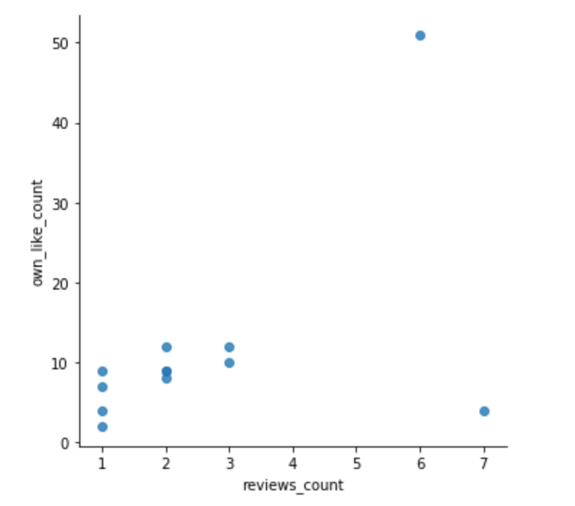
Active users – where they come from?
Why “ – “ ??

Slide 13
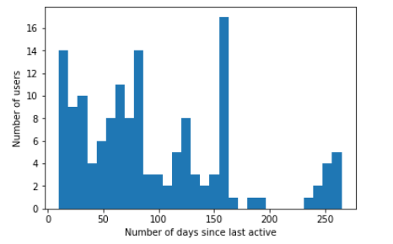
Active users from jan – What about in the last 60 days ?
ONLY 35.86% active in the last 2 months

Slide 14
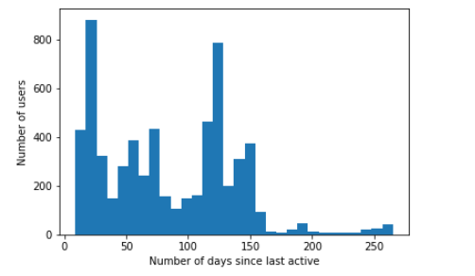
InActive users from jan – What about in the last 60 days ?
39.34% active in the last two months.
Still have the opportunity to get them back!

Slide 15
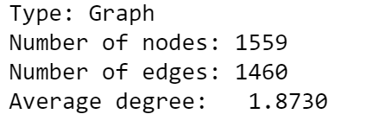
Social network analysis
Intentionally do 167 central users
70 overlaps with the High Active Users detected in K-means clustering
Filter out inactive users in the last 2 months
➔ 24 best of the best candidates for Ambassador program

Slide 16
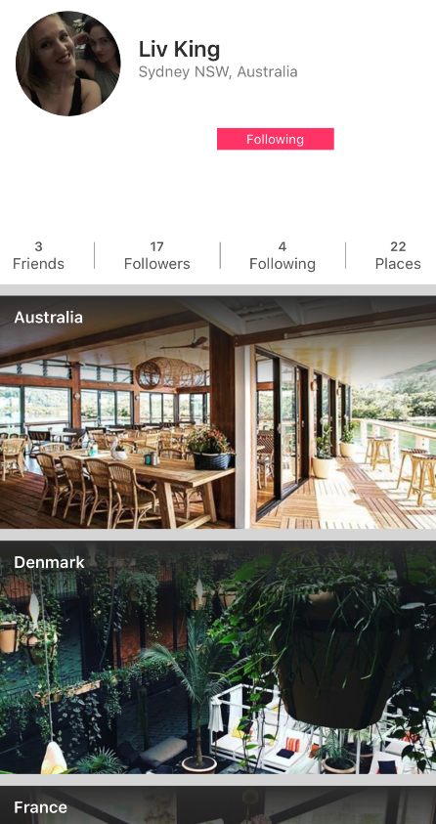
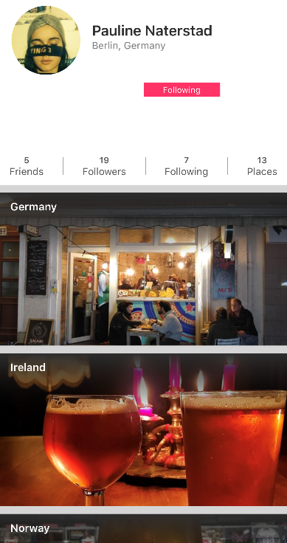
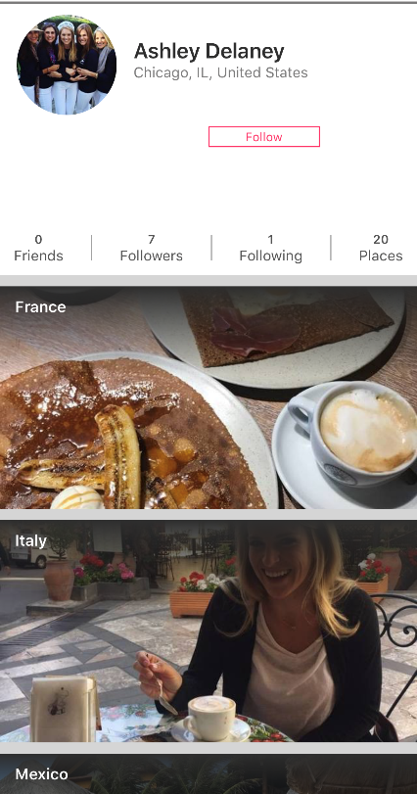
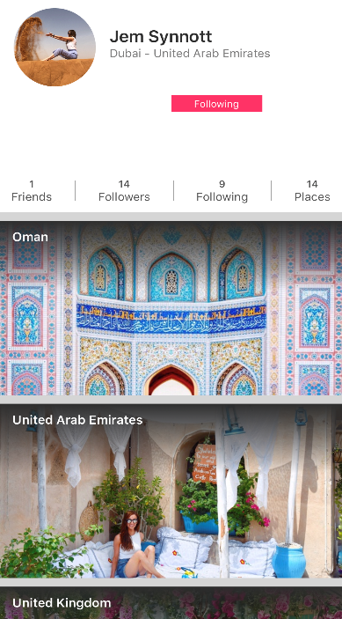
BEST OF THE BEST CANDIDATES

Slide 17
Recommendations
Combine results from K-means clustering, SNA and recent filter to select the best users for Ambassador Program.
* Models can always be replicated – but need judgements (UN-SUPERVISED algorithms).
Focus on the most active markets.
Send out Promotions, Pop ups, Ambassador Request in most active hours.
Ask those who disable location services to try out search toolbar to increase user experience.
Check SNA models regularly to see the interaction and connection of the community.

Slide 18
Future Works
Add the weight of relationship in Social Network Analysis (follower v.s. following)
Seen_count and search_count could be excluded
Study the inactive group more to develop a different strategy for them?
Investigate what made a user clicks like/ wish list a review/ place ➔ Better recommender systems for greater users' interaction.

Slide 19


